Slide 1
System Architecture Directions for a Software-Defined Lighting Infrastructure
Pat Pannuto, with Ye-Sheng Kuo and Prabal Dutta
University of Michigan
1st ACM Workshop on Visible Light Communications Systems (VLCS ‘14)
September 7, Maui, HI

Slide 2
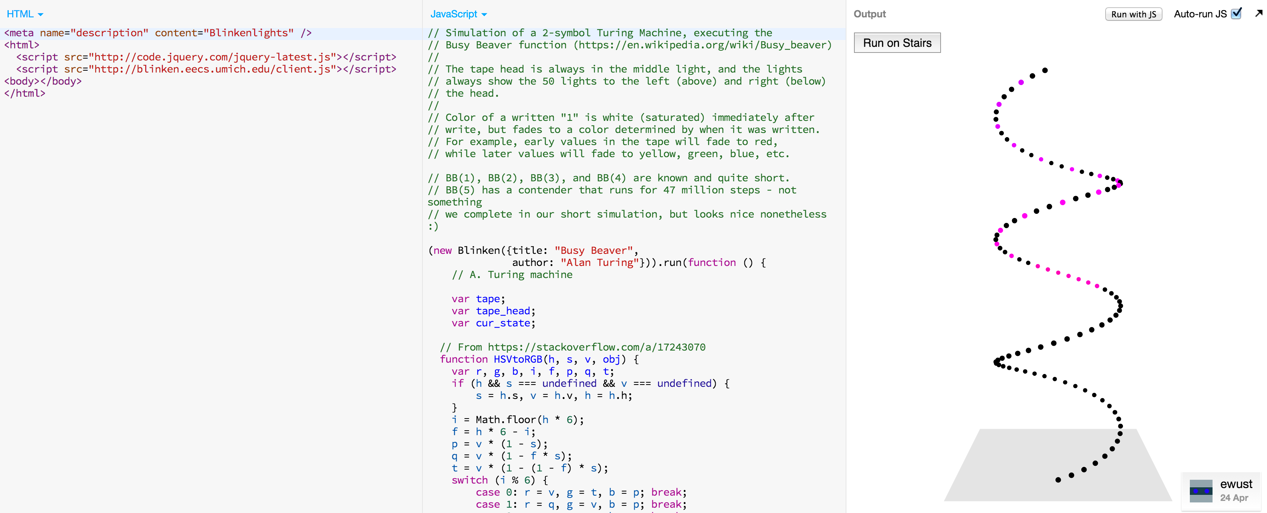
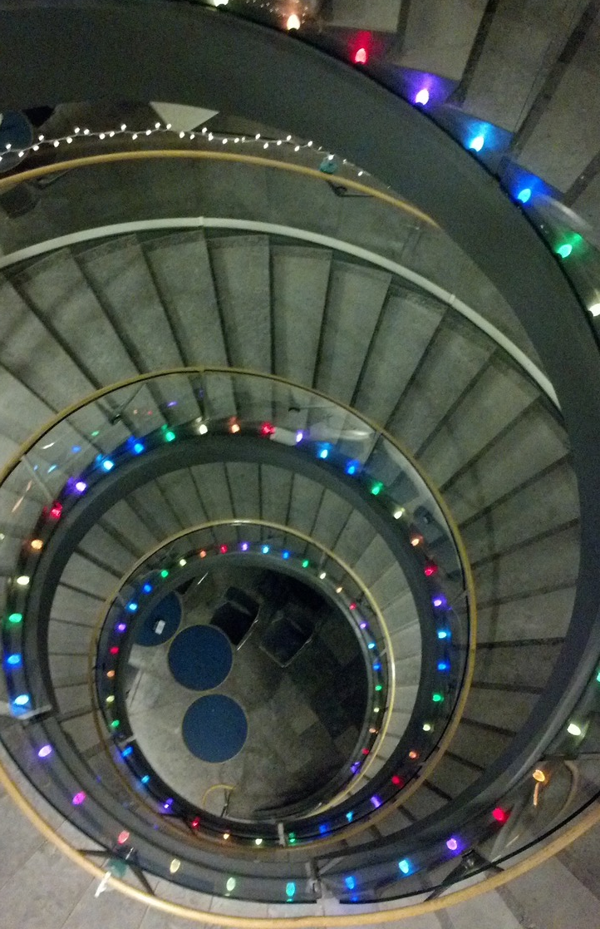
Blinken: Software-Defined Lighting (@ the Bob and Betty Beyster Building)
http://blinken.eecs.umich.edu/

Slide 3
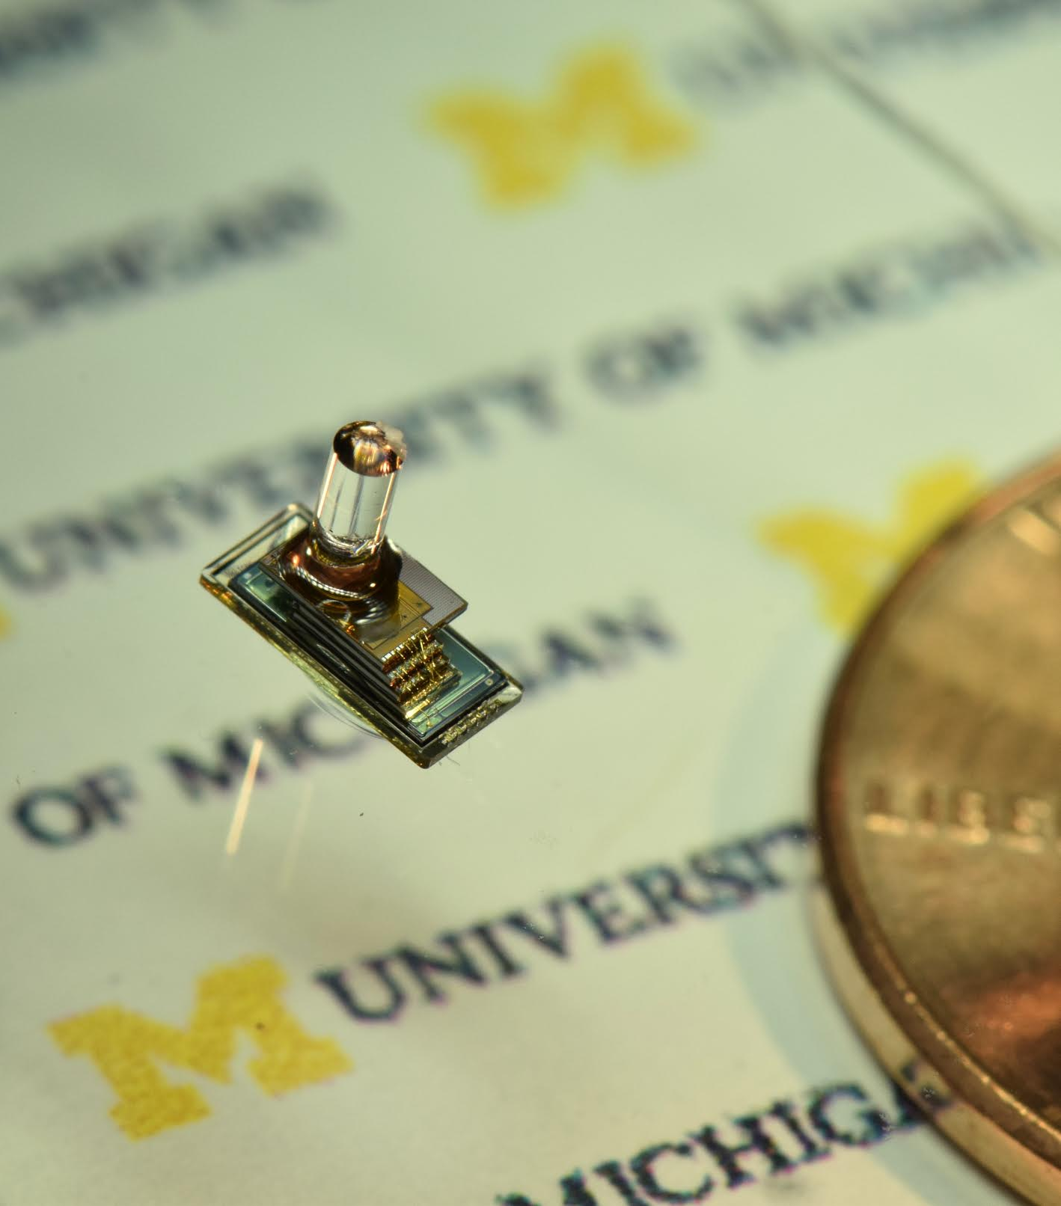
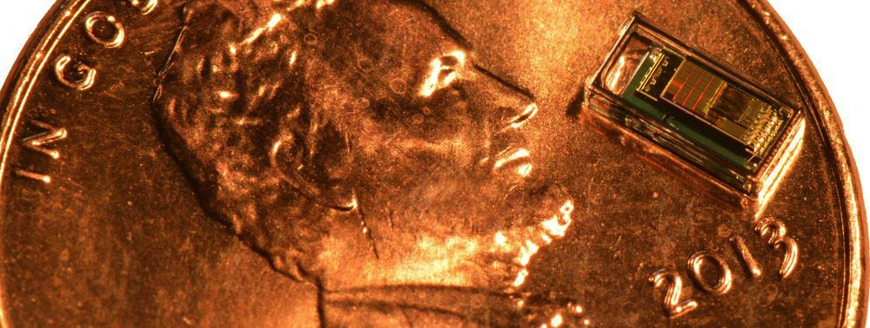
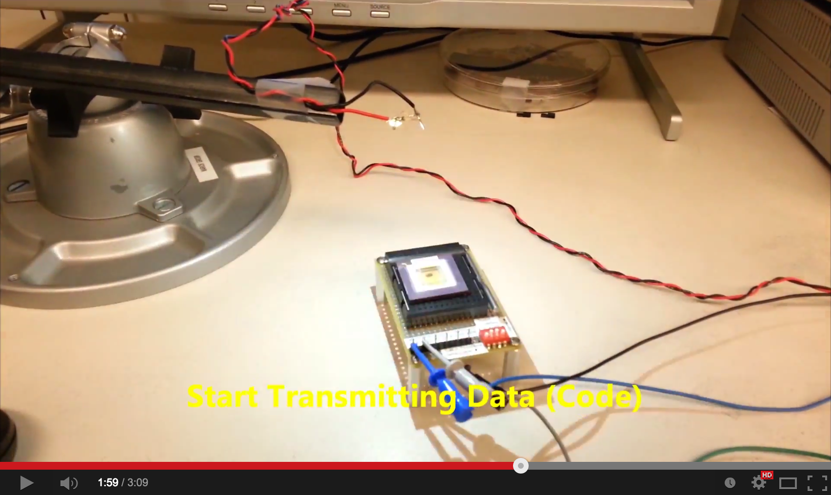
M³: Programming Smart Dust with VLC
https://www.youtube.com/watch?v=OM8WgnhcyOo#t=118

Slide 4
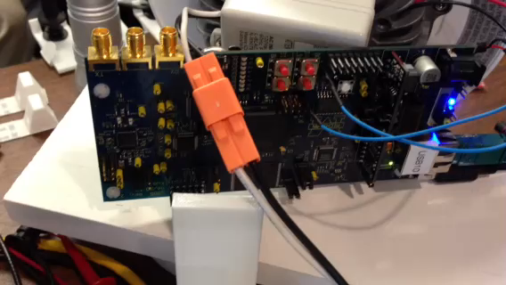
Electric Imp: Commercial systems also employ VLC for programming
Applications beyond programming: Synchronization

Slide 5
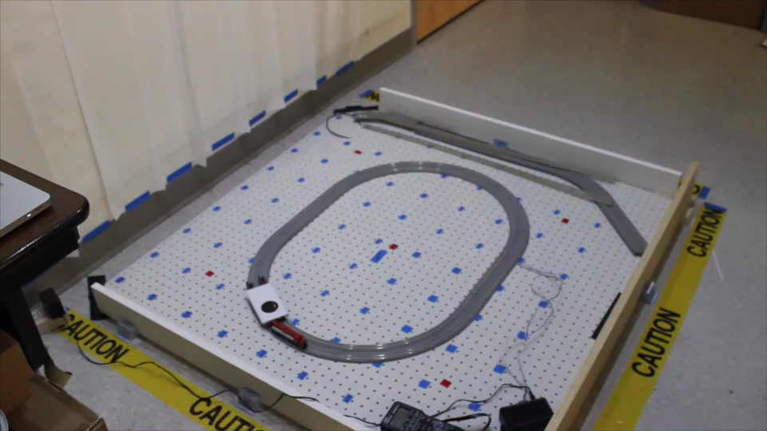
Luxapose: Accurate Indoor Positioning with VLCP

Slide 6

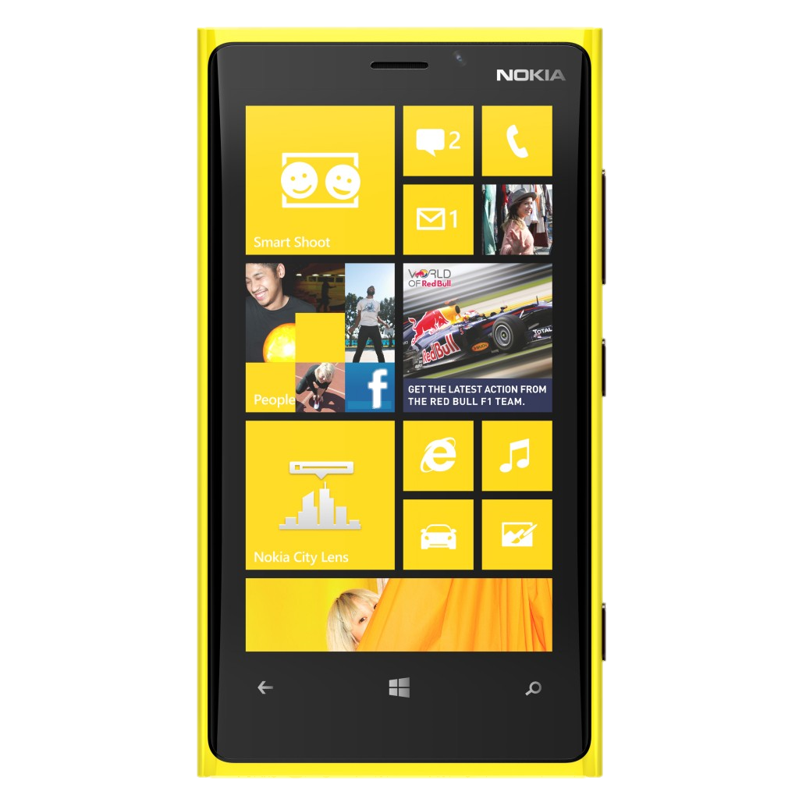
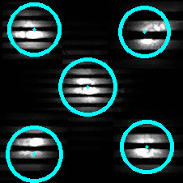
What do all of these examples have in common?

Slide 7
What don’t all of these examples have in common?

Slide 8
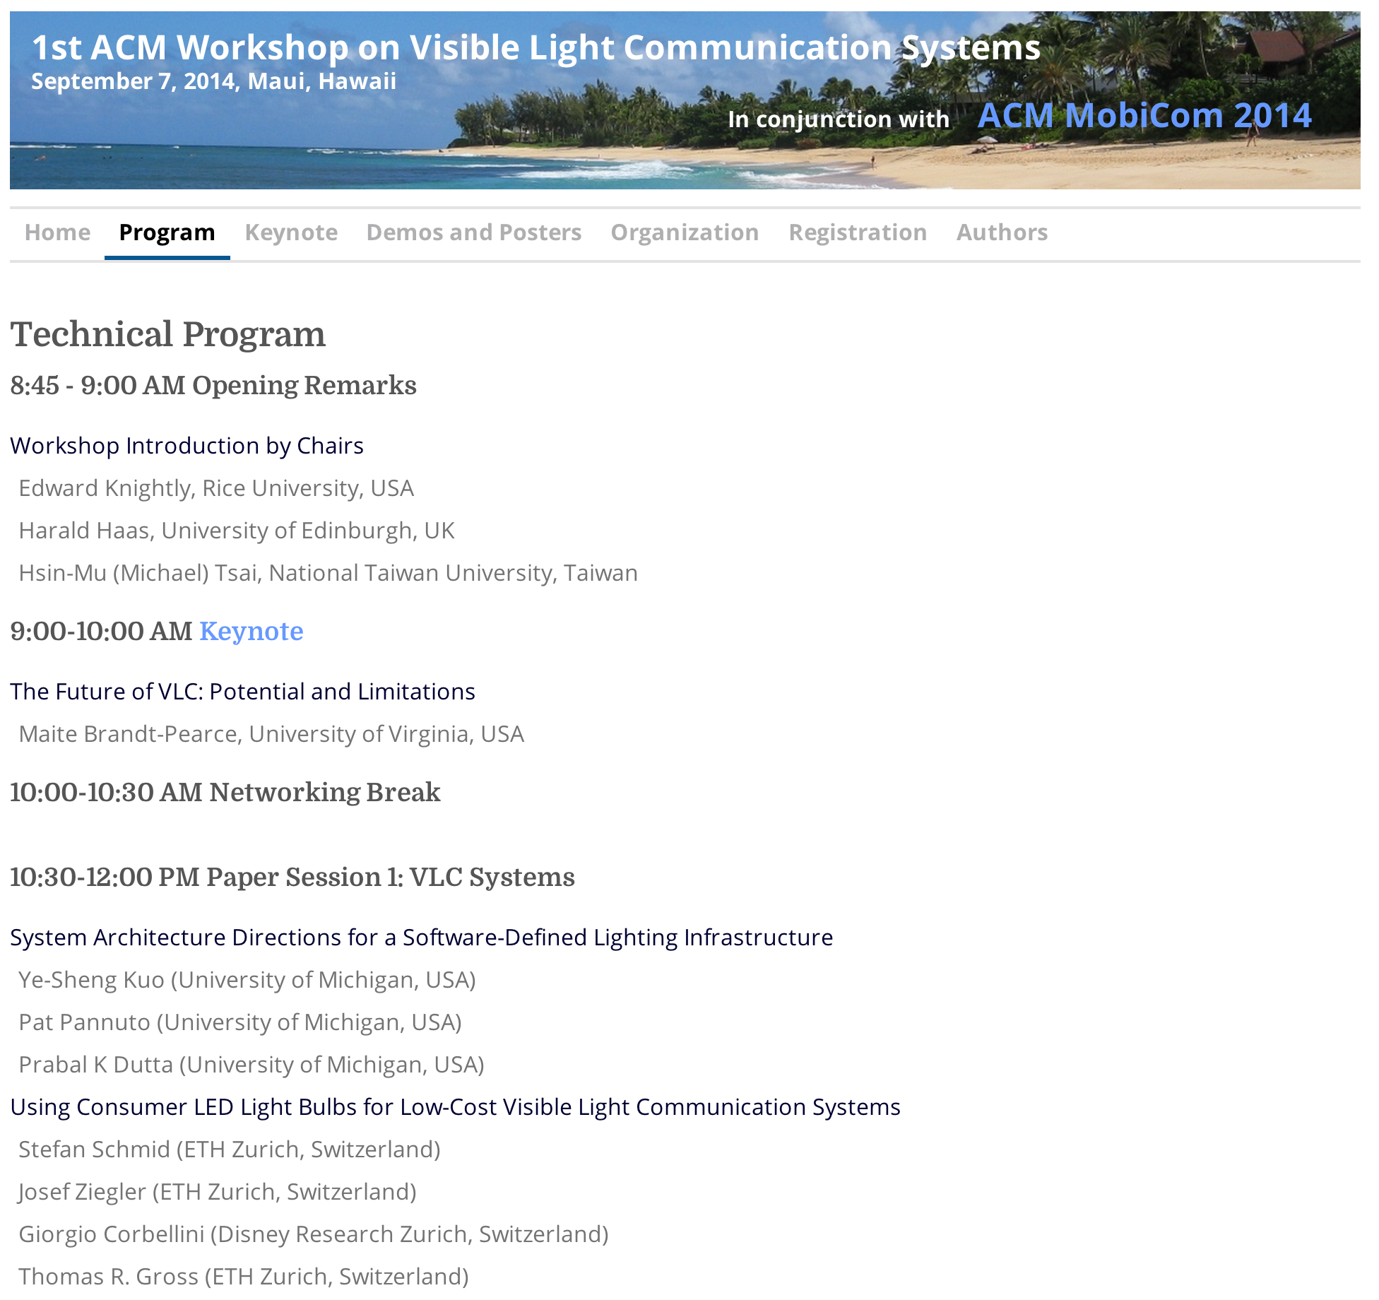
Show of hands: Are you using someone else’s infrastructure?

Slide 9
Vision for a modular SDL architecture
Luminaries
IP Backbone
Cloud/Cloudlet
Receivers

Slide 10
Taking lessons from Software Defined Networking into Software Defined Lighting
Separate Control and Data Planes
Preserves Flexibility
Installed lights do not need to know every protocol a priori

Slide 11
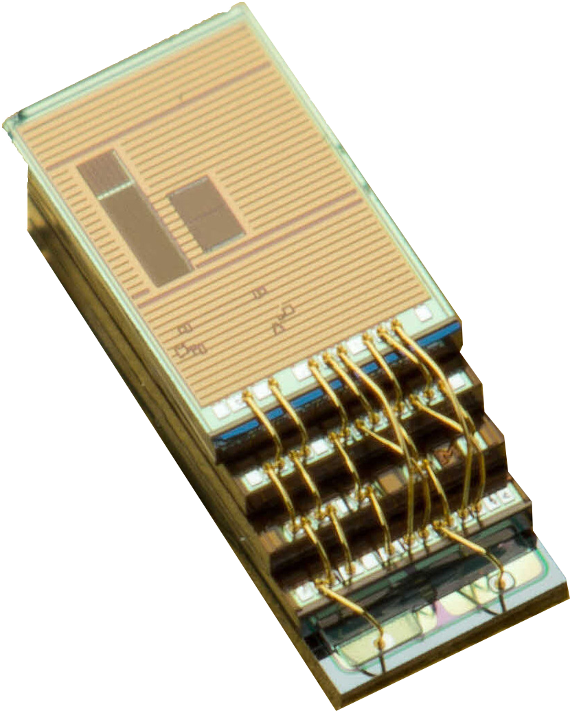
The Capabilities of VLC Receivers Vary Greatly
Diffusing (single photodiode)
Simpler devices
→ Less computation capability
Cannot distinguish transmitters
Requires temporal signal diversity
Array (multiple photocell)
Can distinguish transmitters
Temporal or spatial diversity

Slide 12
The Backbone Design Can Have Far-Reaching Implications on SDL Capability
Ethernet vs PLC vs RF
Infrastructure cost, per-node cost
Bandwidth, throughput, and latency tradeoffs
Impact on synchronization capabilities

Slide 13
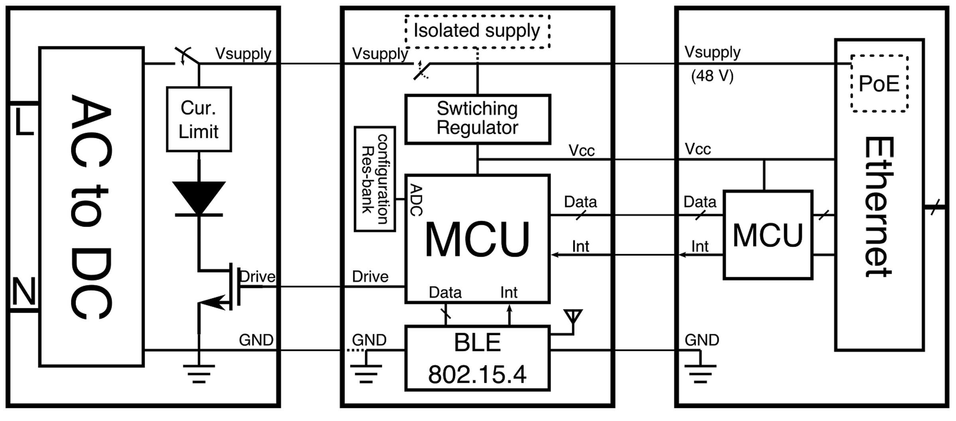
The Luminary Decomposes into Three Independent Modules
Computation
& Control
Optical Frontend
Communication

Slide 14
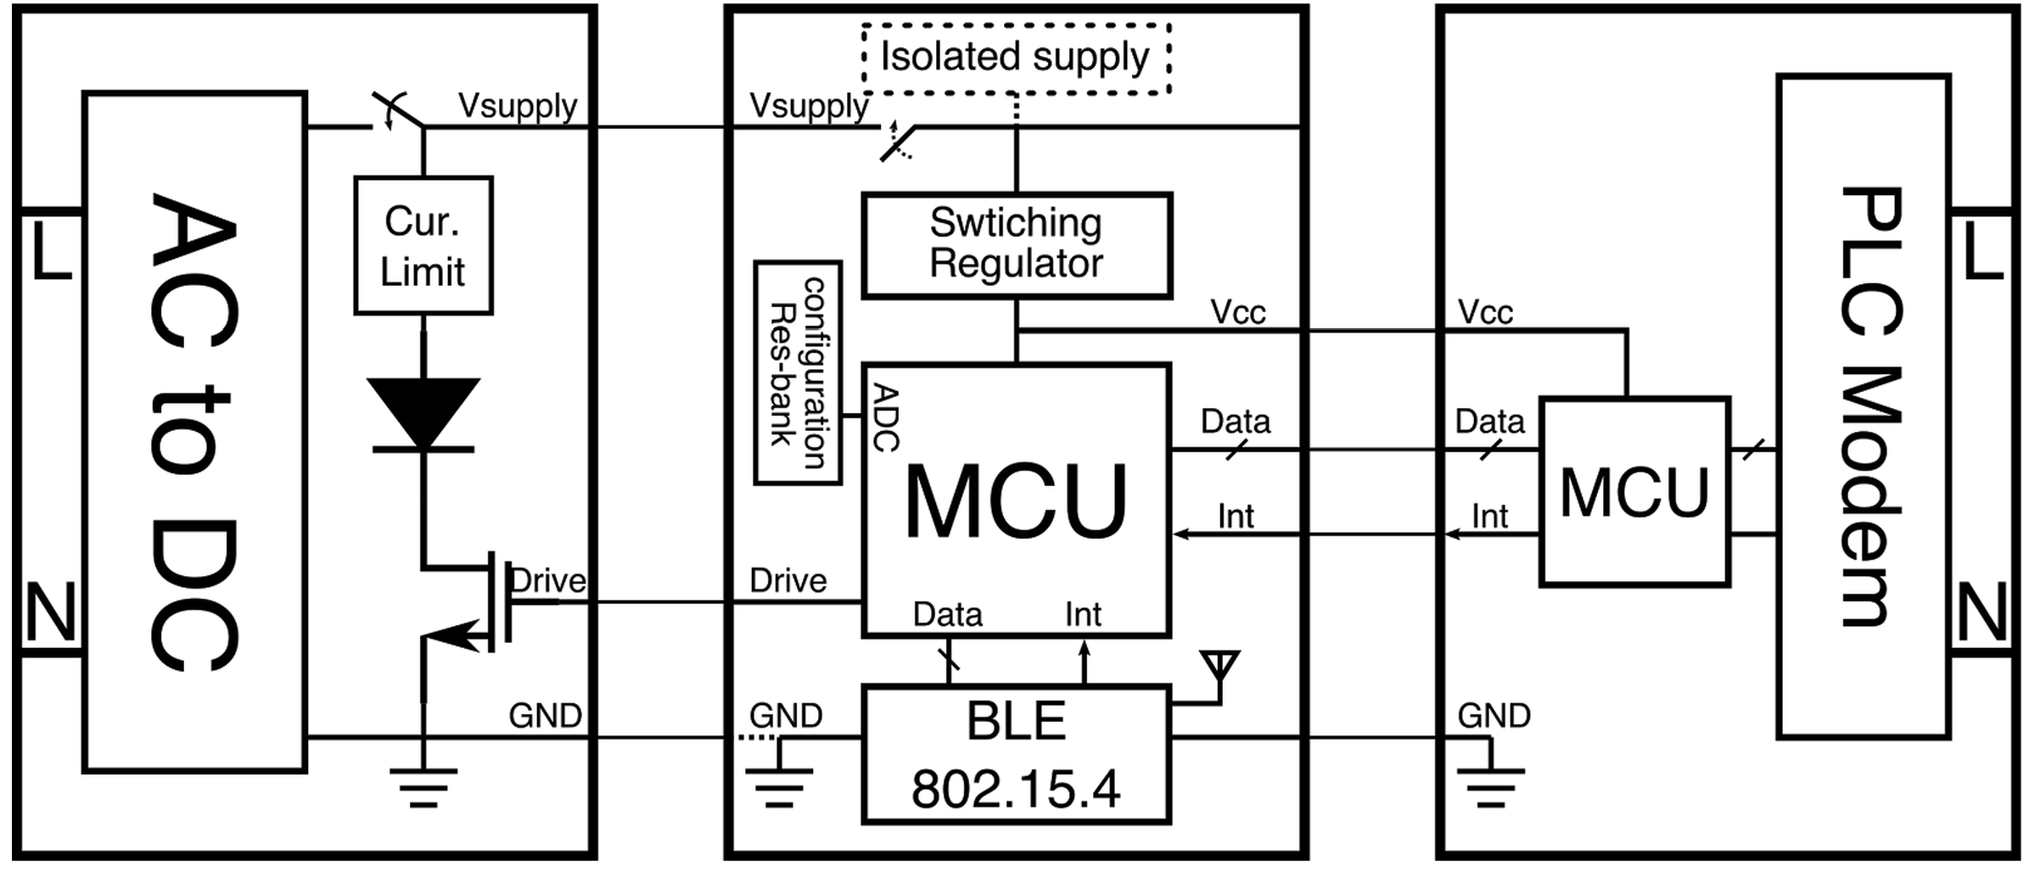
The Luminary Decomposes into Three Independent Modules
Computation
& Control
Optical Frontend
Communication

Slide 15
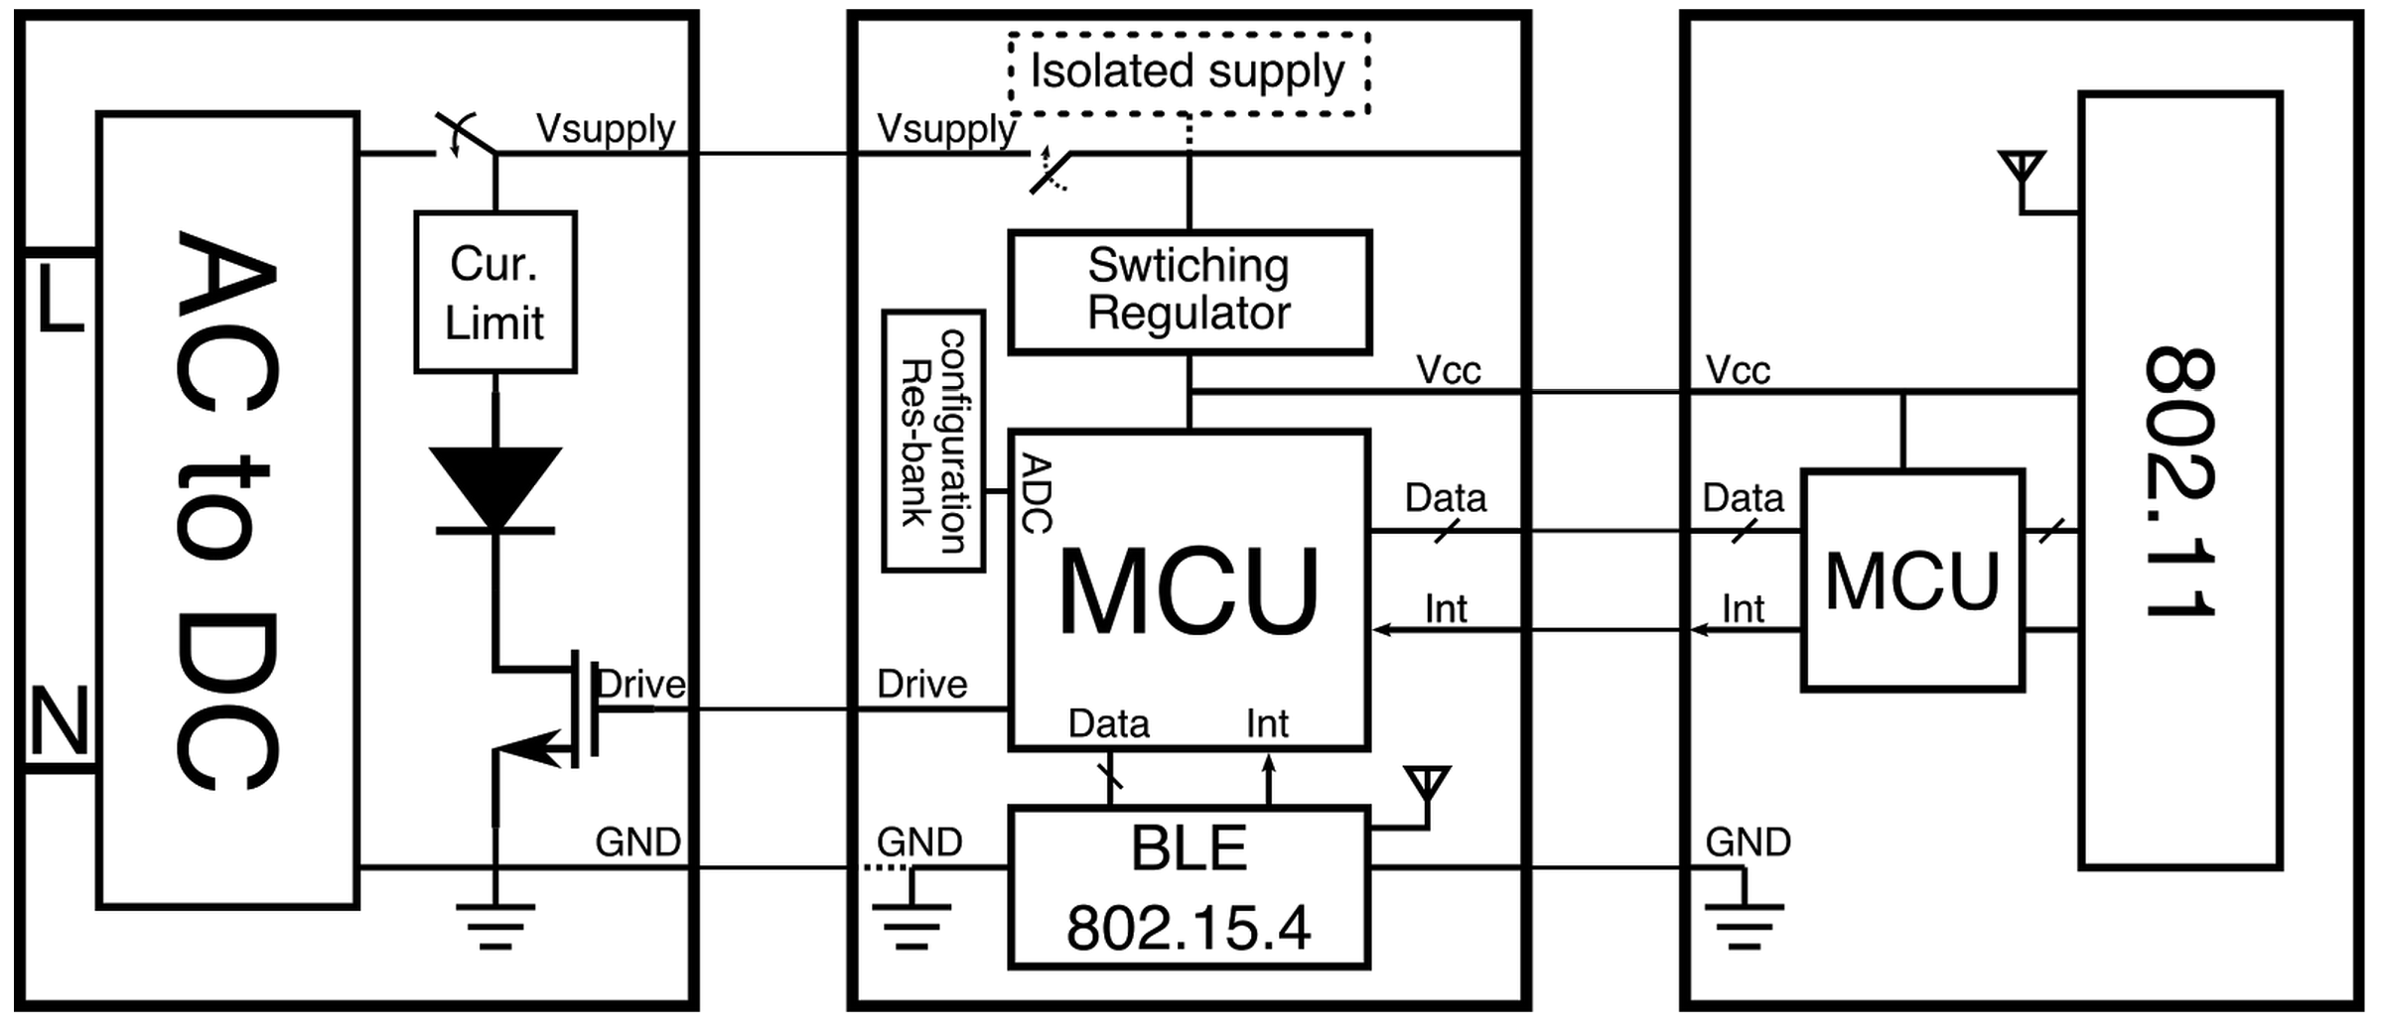
The Luminary Decomposes into Three Independent Modules
Computation
& Control
Optical Frontend
Communication

Slide 16
Different Modules Add Different Costs to Each Bulb
Communication
PHY frontend
Antenna?
Coupled transformer?
Baseband processor
Computation & Control
General-purpose (MCU)
Flexible fixed function (e.g., tunable oscillator)
Power Supply
Above likely require lower voltage, perhaps isolation
Perhaps a 4th module?

Slide 17
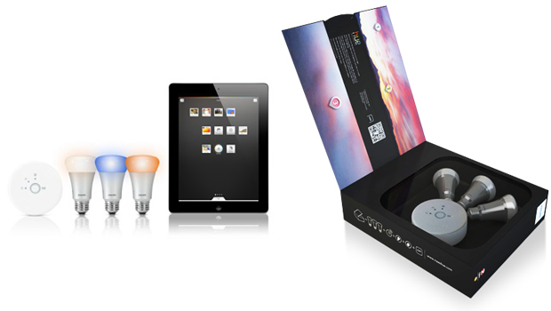
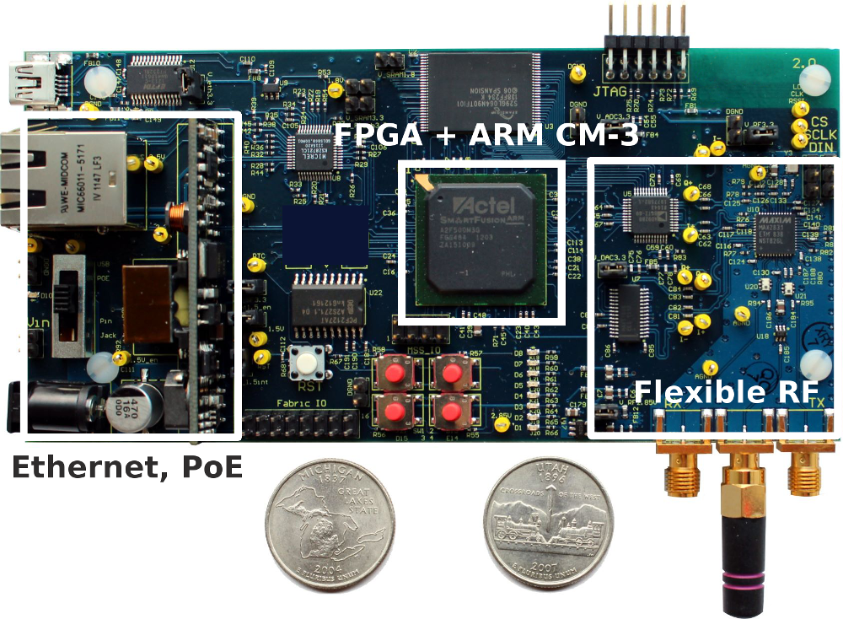
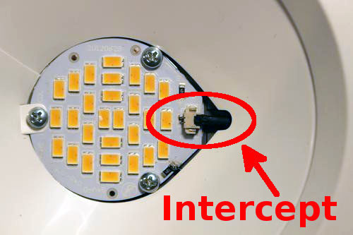
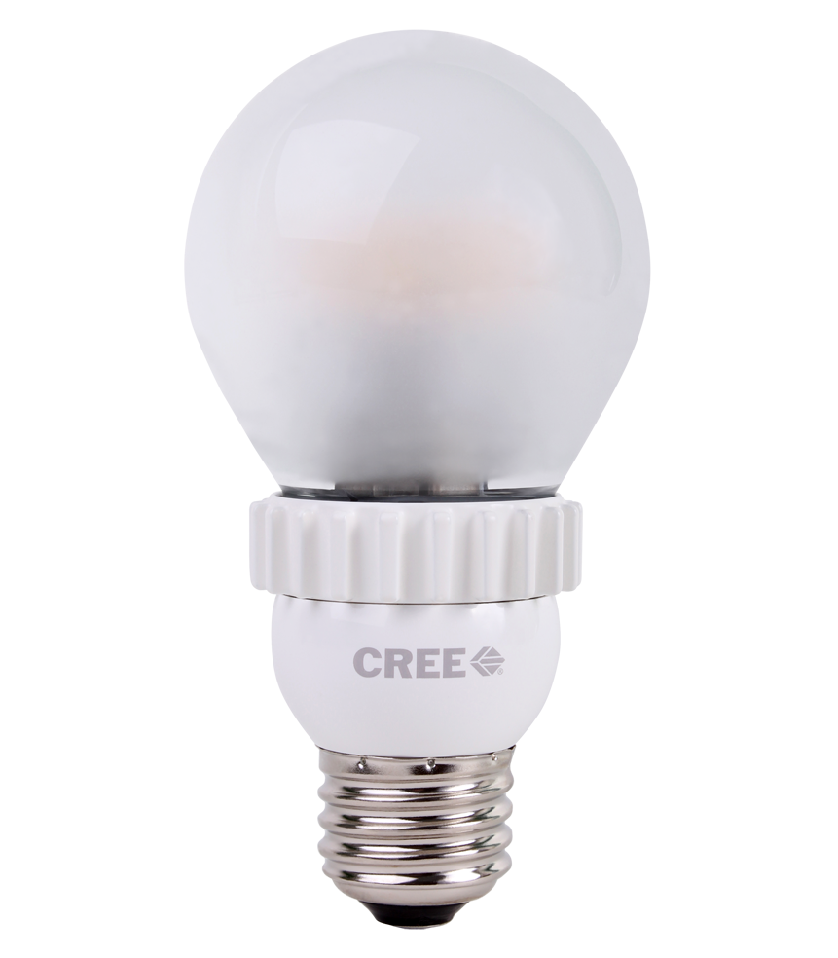
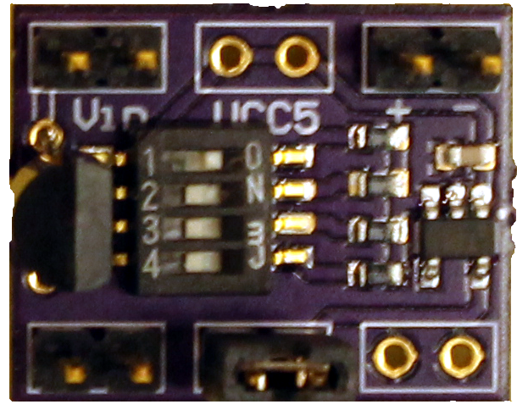
Evaluating the value-add of the smart bulb
Cost
Capability

Slide 18
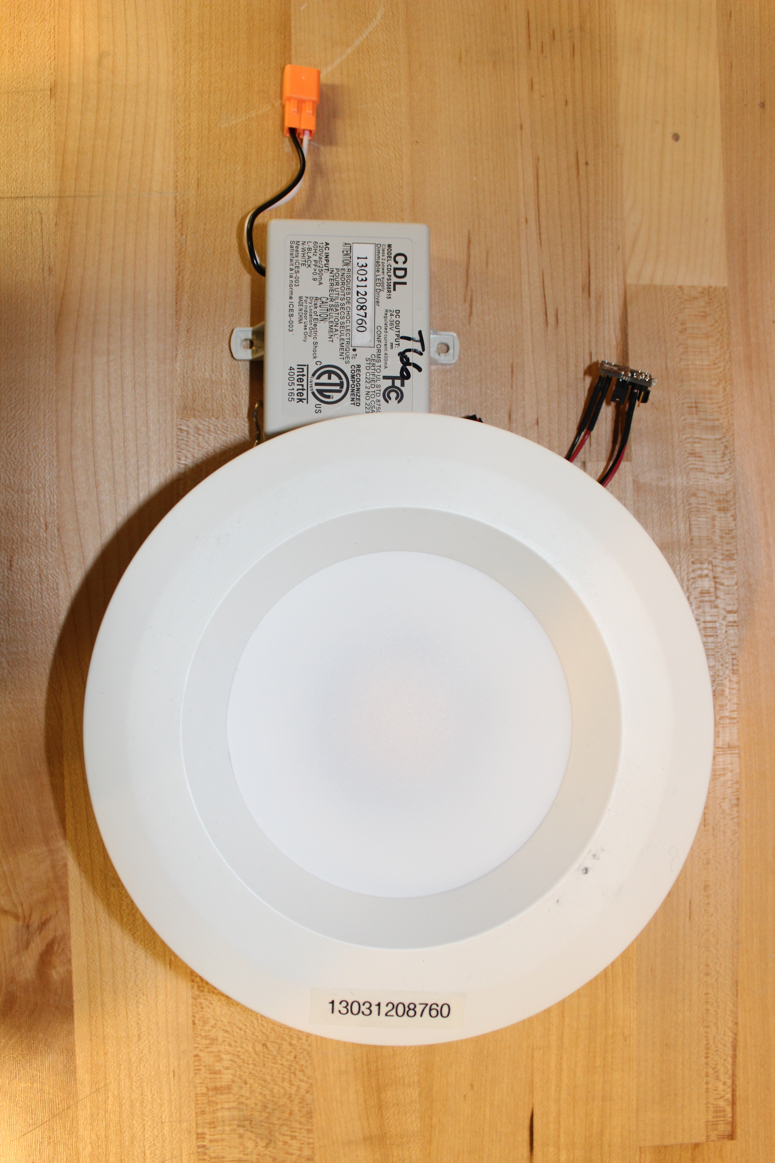
How to determine what costs make sense to pay in LED bulbs?
Start with the kitchen sink and see what’s useful

Slide 19
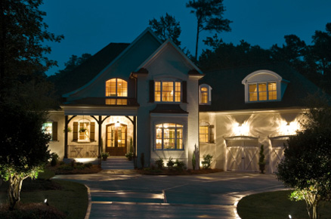
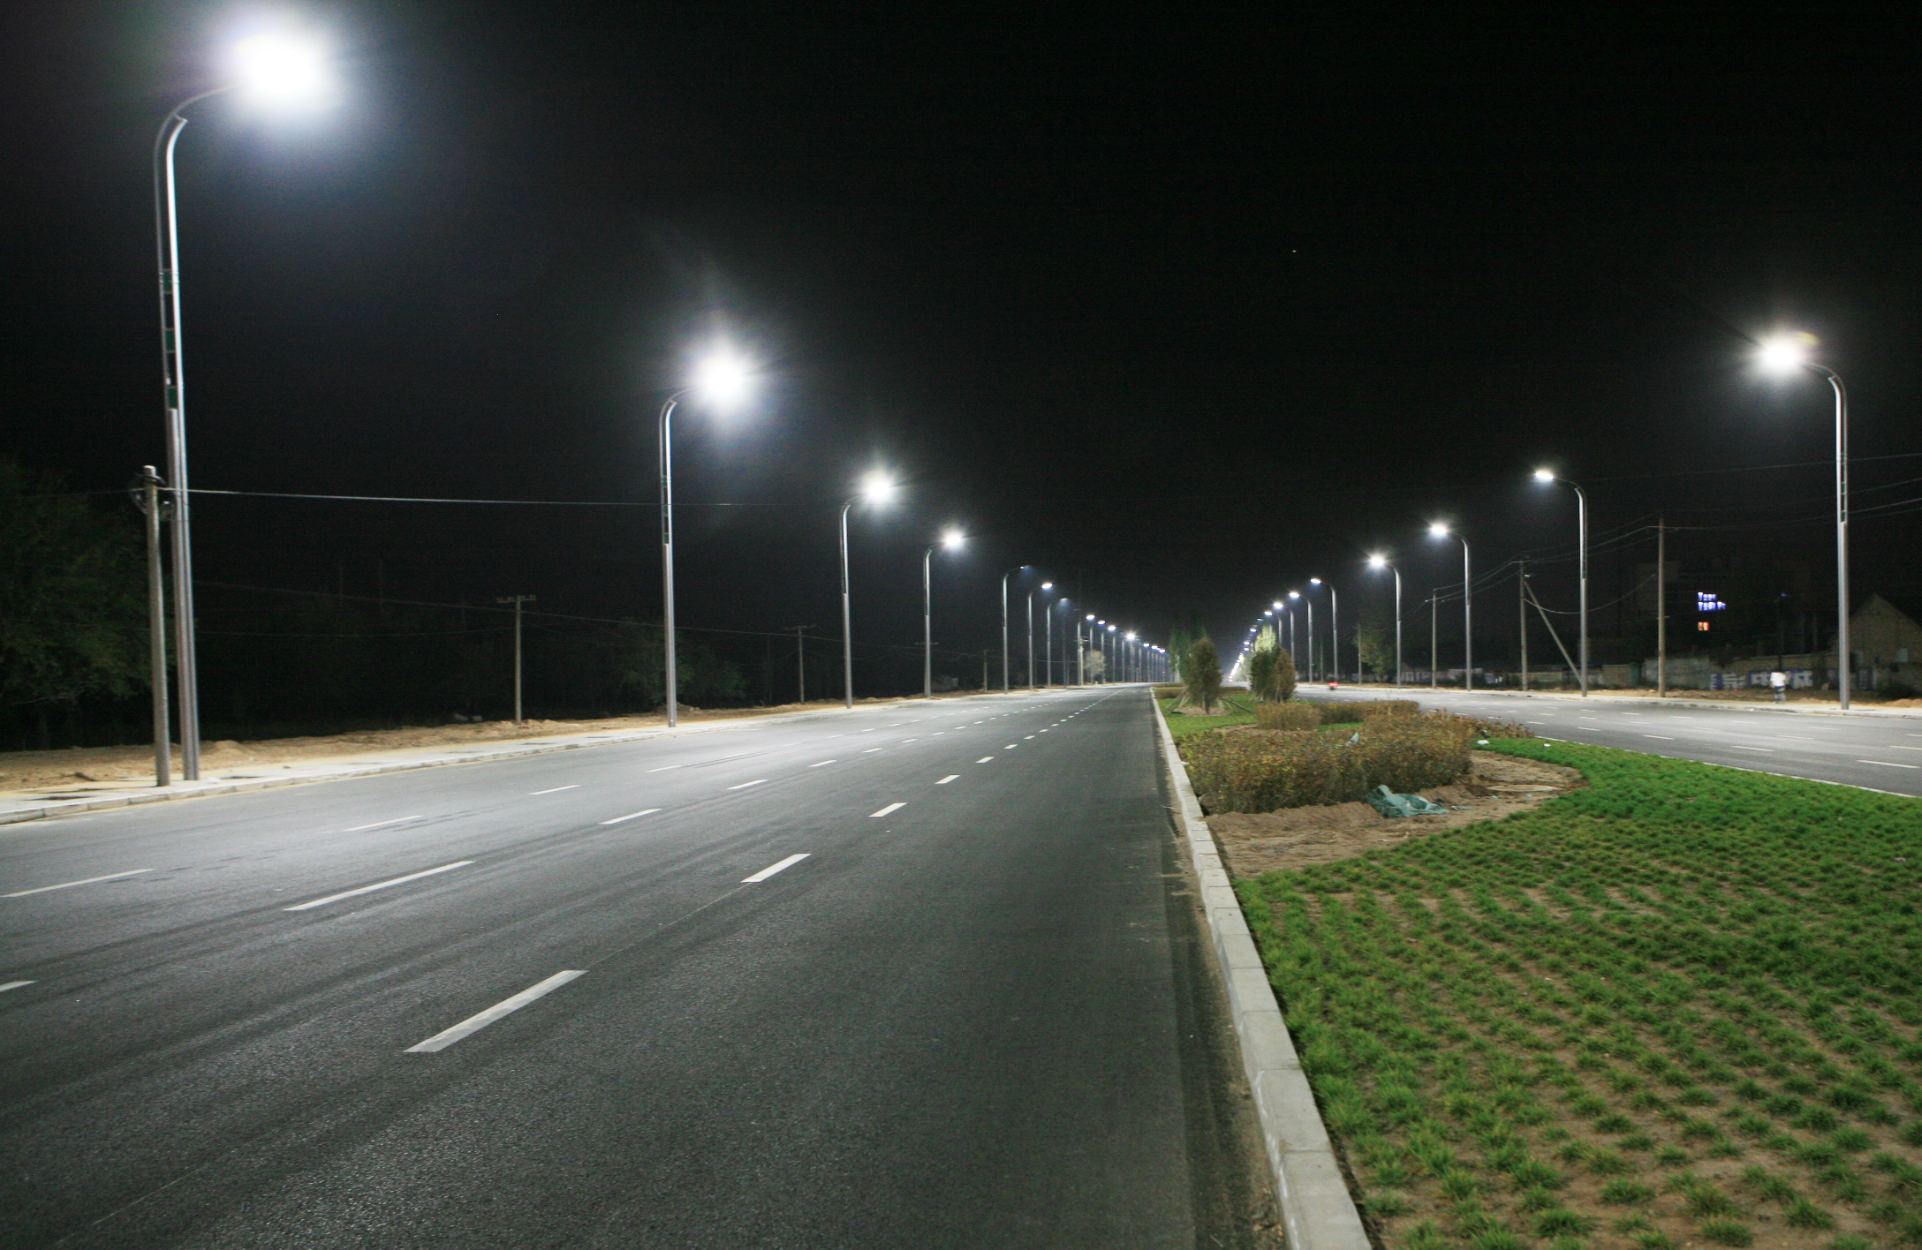
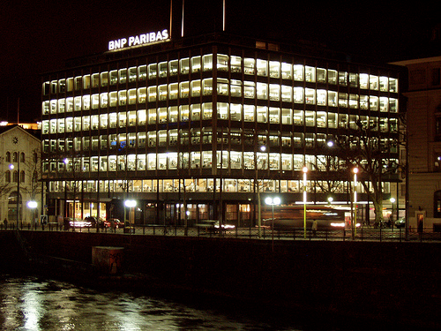
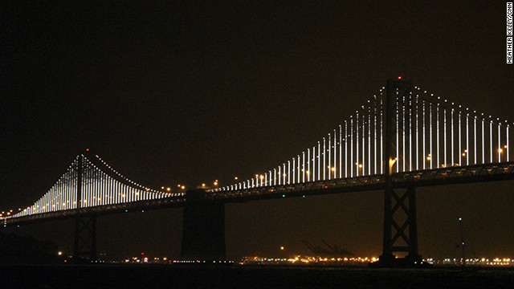
Lights are rarely isolated, and the whole must be greater than the sum of its parts
No bulb stands alone.

Slide 20
Mapping Applications onto a Network of Software Defined Lights
Health
Passive, Continuous Background Service
Targets Humans
Localization
Passive, Continuous Background Service
Targets Array Receivers (Phones)
Synchronization
Passive, Continuous Background Service
Targets Diffusing Device
Location Attestation
Active, One-Shot Service
Targets Active Device, Diffusing or Array

Slide 21
Can disjoint services multiplex on the same physical lighting network?
Localization Service
Synchronization Event

Slide 22
With sufficient synchronization, transmitted signals can constructively interfere

Slide 23
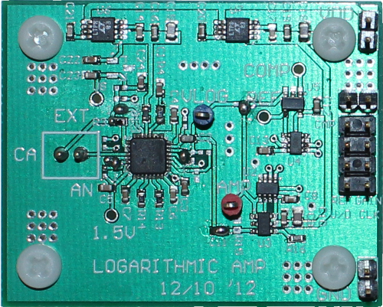
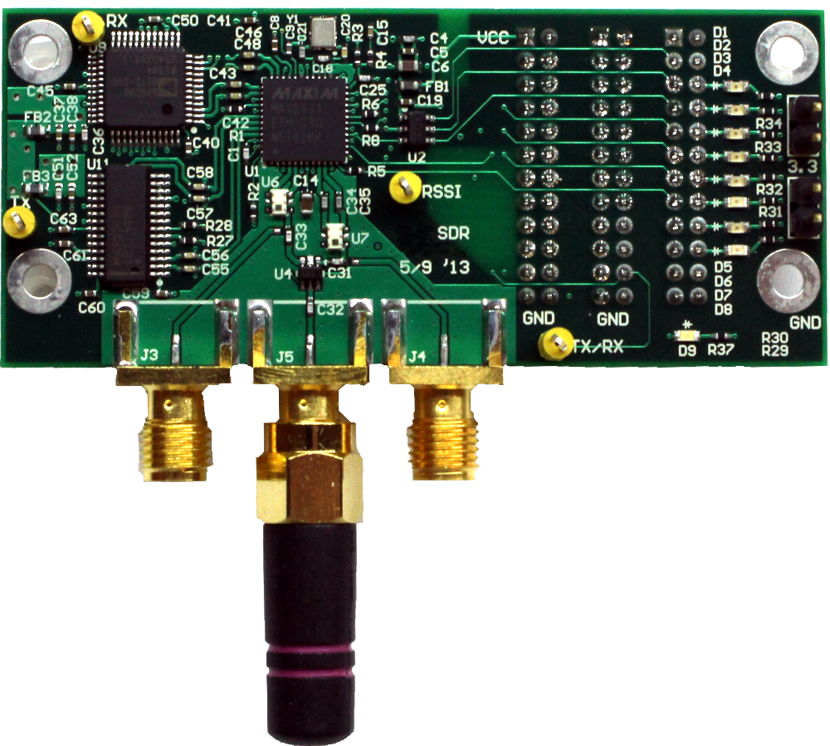
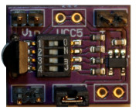
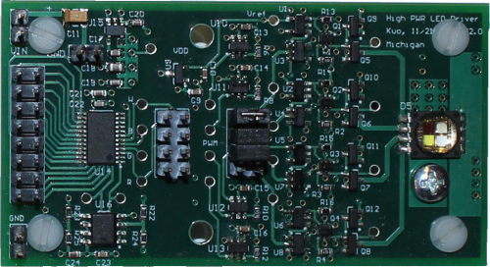
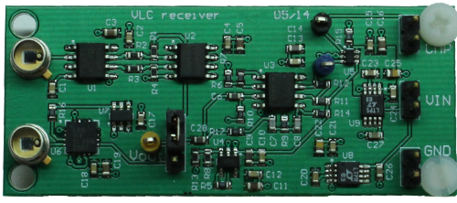
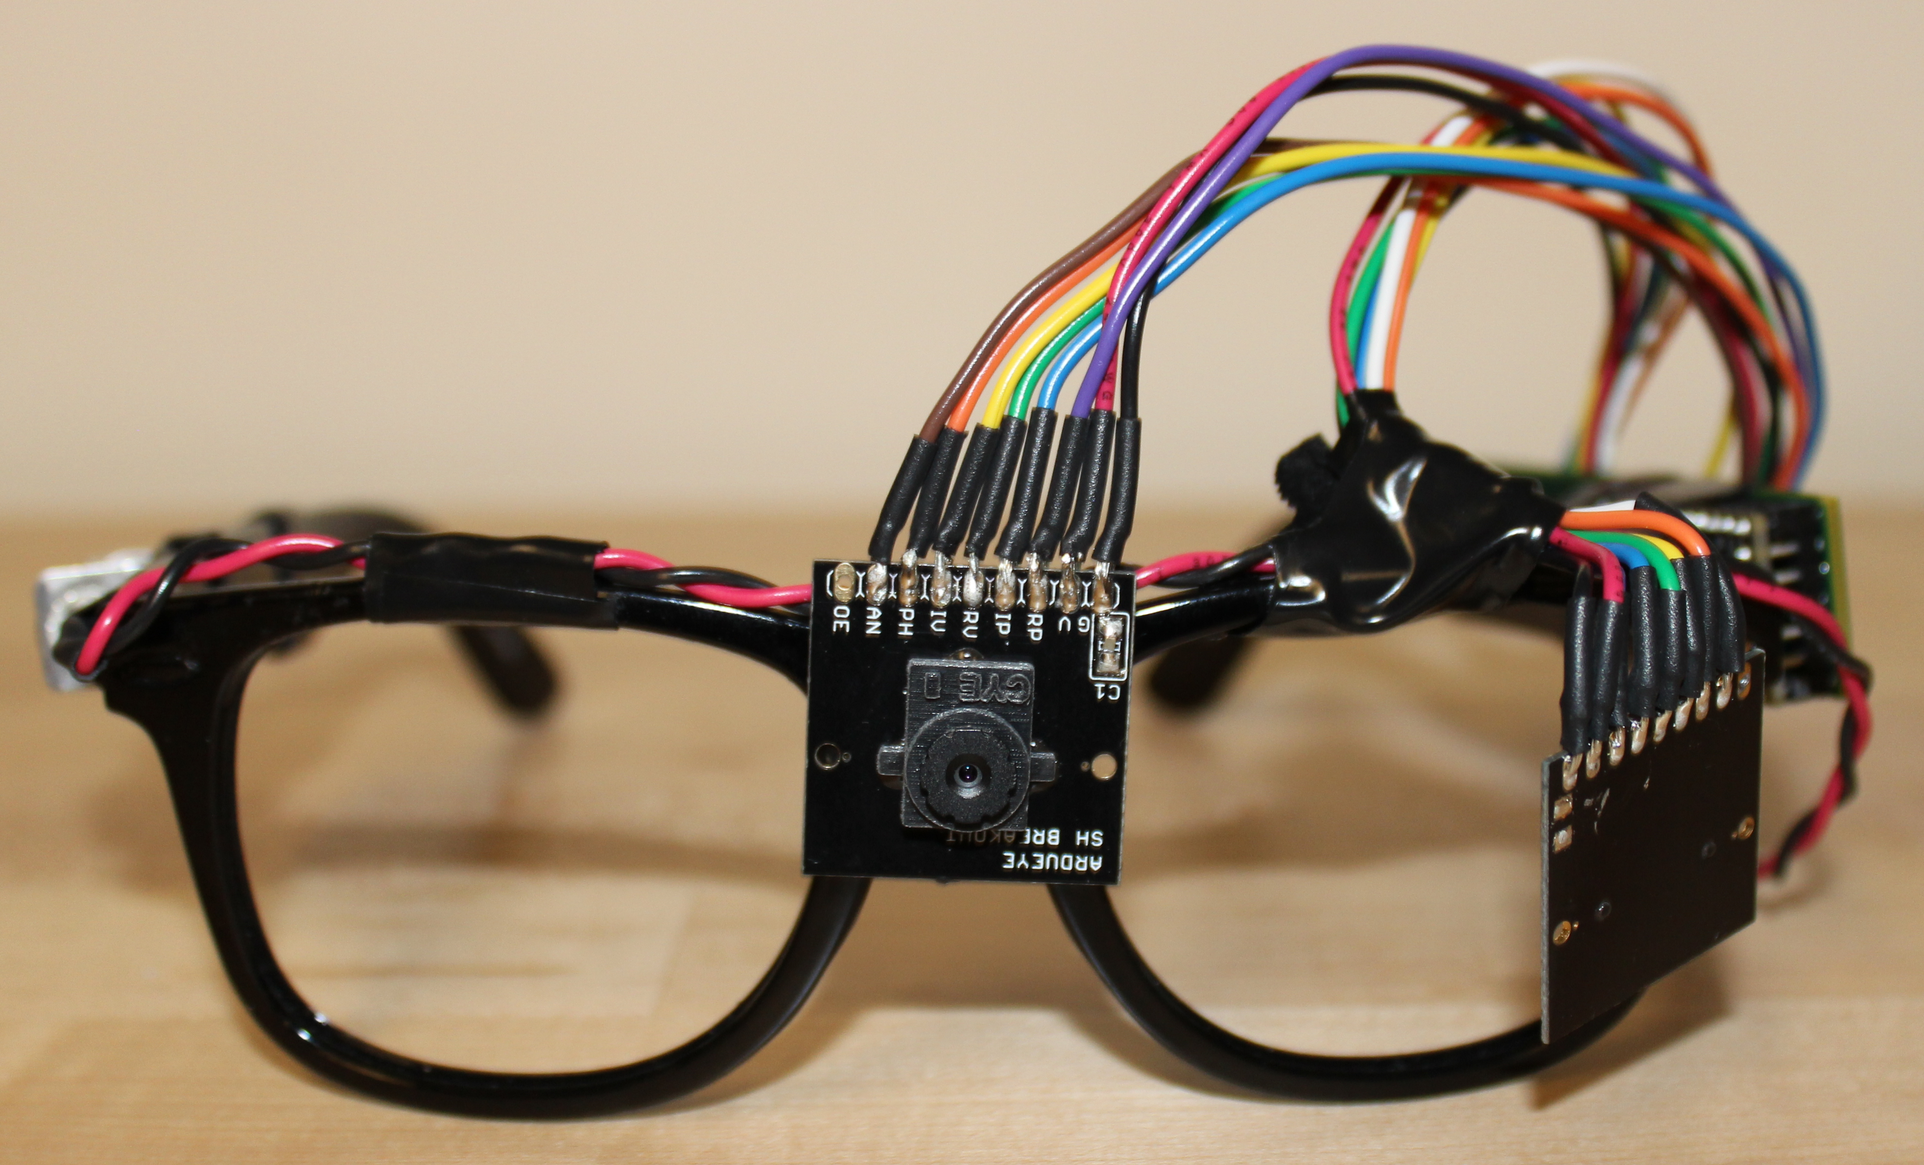
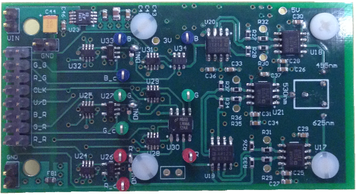
First Steps Towards Realizing an SDL Architecture

Slide 24
Why are LED bulbs such celebrated technology?
Efficient:
100 lm/W
Durable:
lifetimes > 50,000 hours
Form Factor:
Compact and flexible
High Color Rendering Index (CRI):
Natural, pleasant light
Wide Temperature Range:
Performs even in cold temperatures
Environmentally Friendly:
No Mercury

Slide 25
They are so much better, that you cannot legally purchase incandescents
European Commission. Commission adopts two regulations to progressively remove from the market non-efficient light bulbs.
http://europa.eu/rapid/press-release_IP-09-411_en.pdf
Ministerial Council for Energy. Energy Labelling and MEPS Program Regulatory Ruling. Australian Government – Department of Industry.
http://www.innovation.gov.au/Energy/EnergyEfficiency/Documents/energy-efficiency/Regulatory-Ruling-Incandescent-Final-v1.pdf
The 100th Congress. Energy Independence and Security Act of 2007. Public Law 110-140. U.S. Government Printing Office.
http://www.gpo.gov/fdsys/pkg/PLAW-110publ140/html/PLAW-110publ140.htm

Slide 26
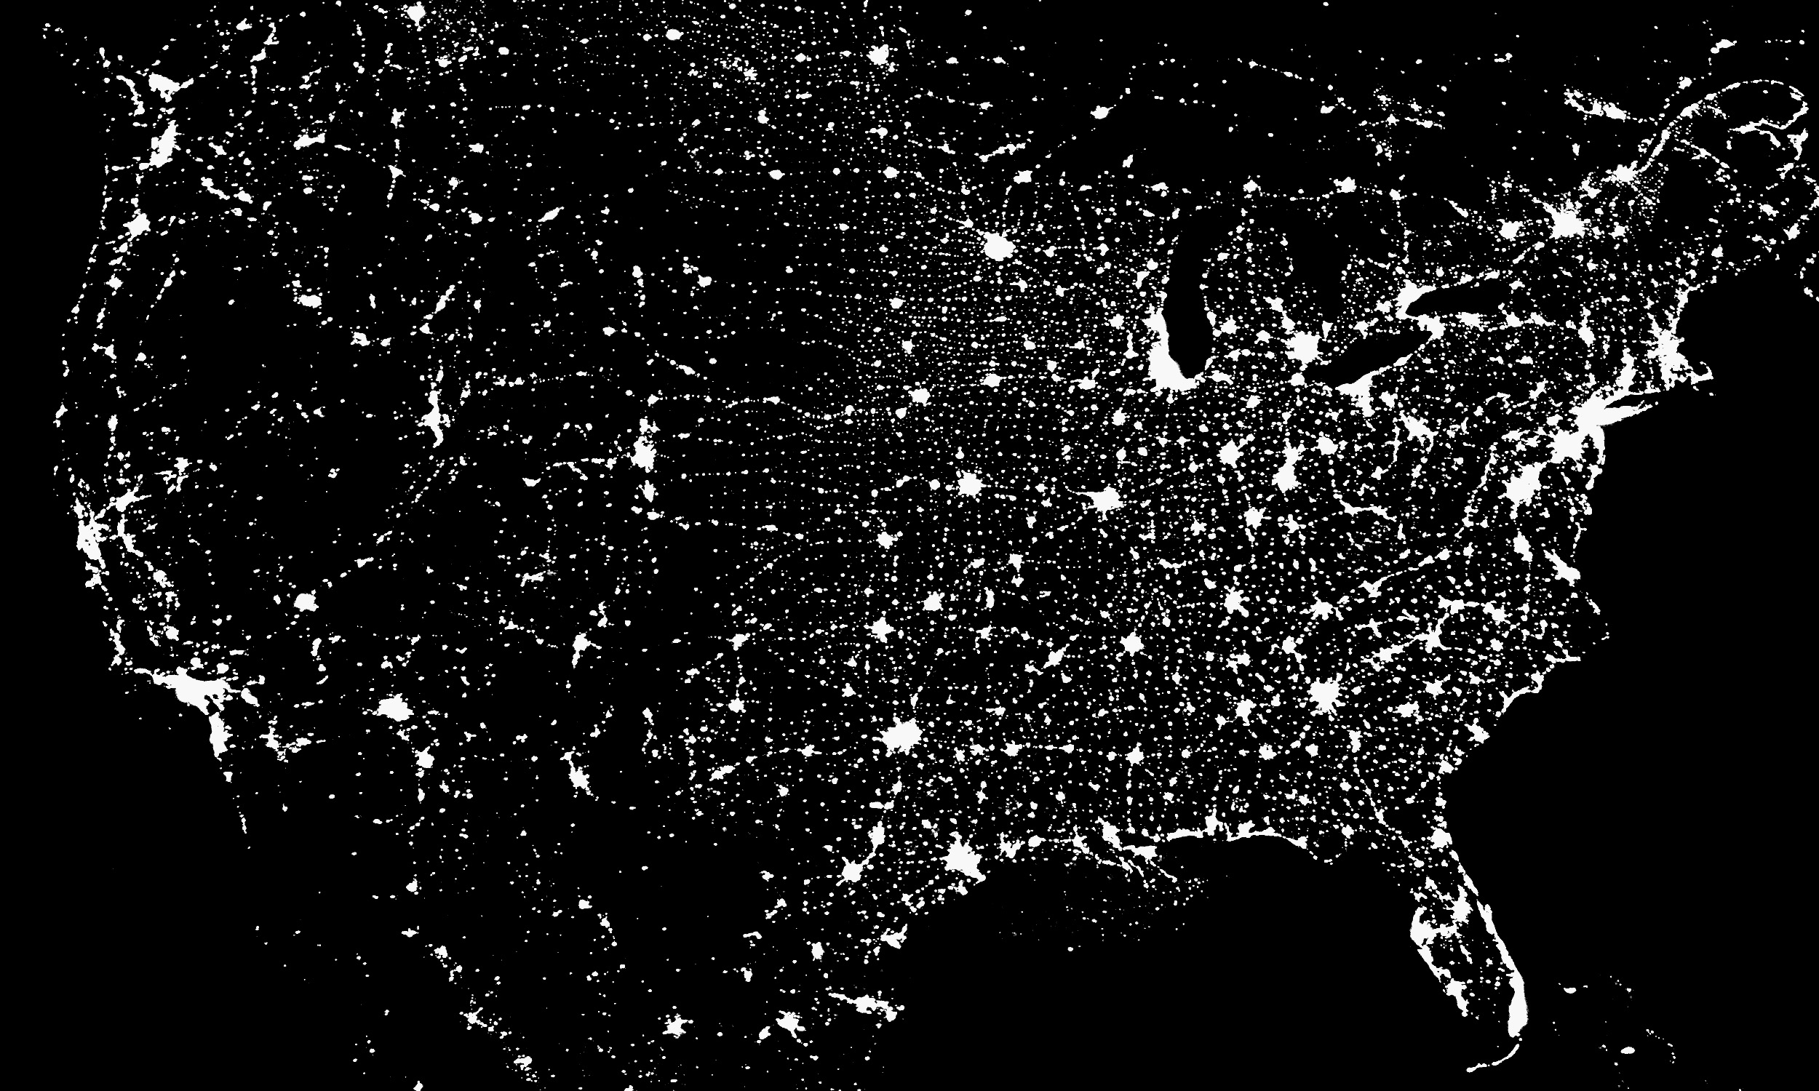
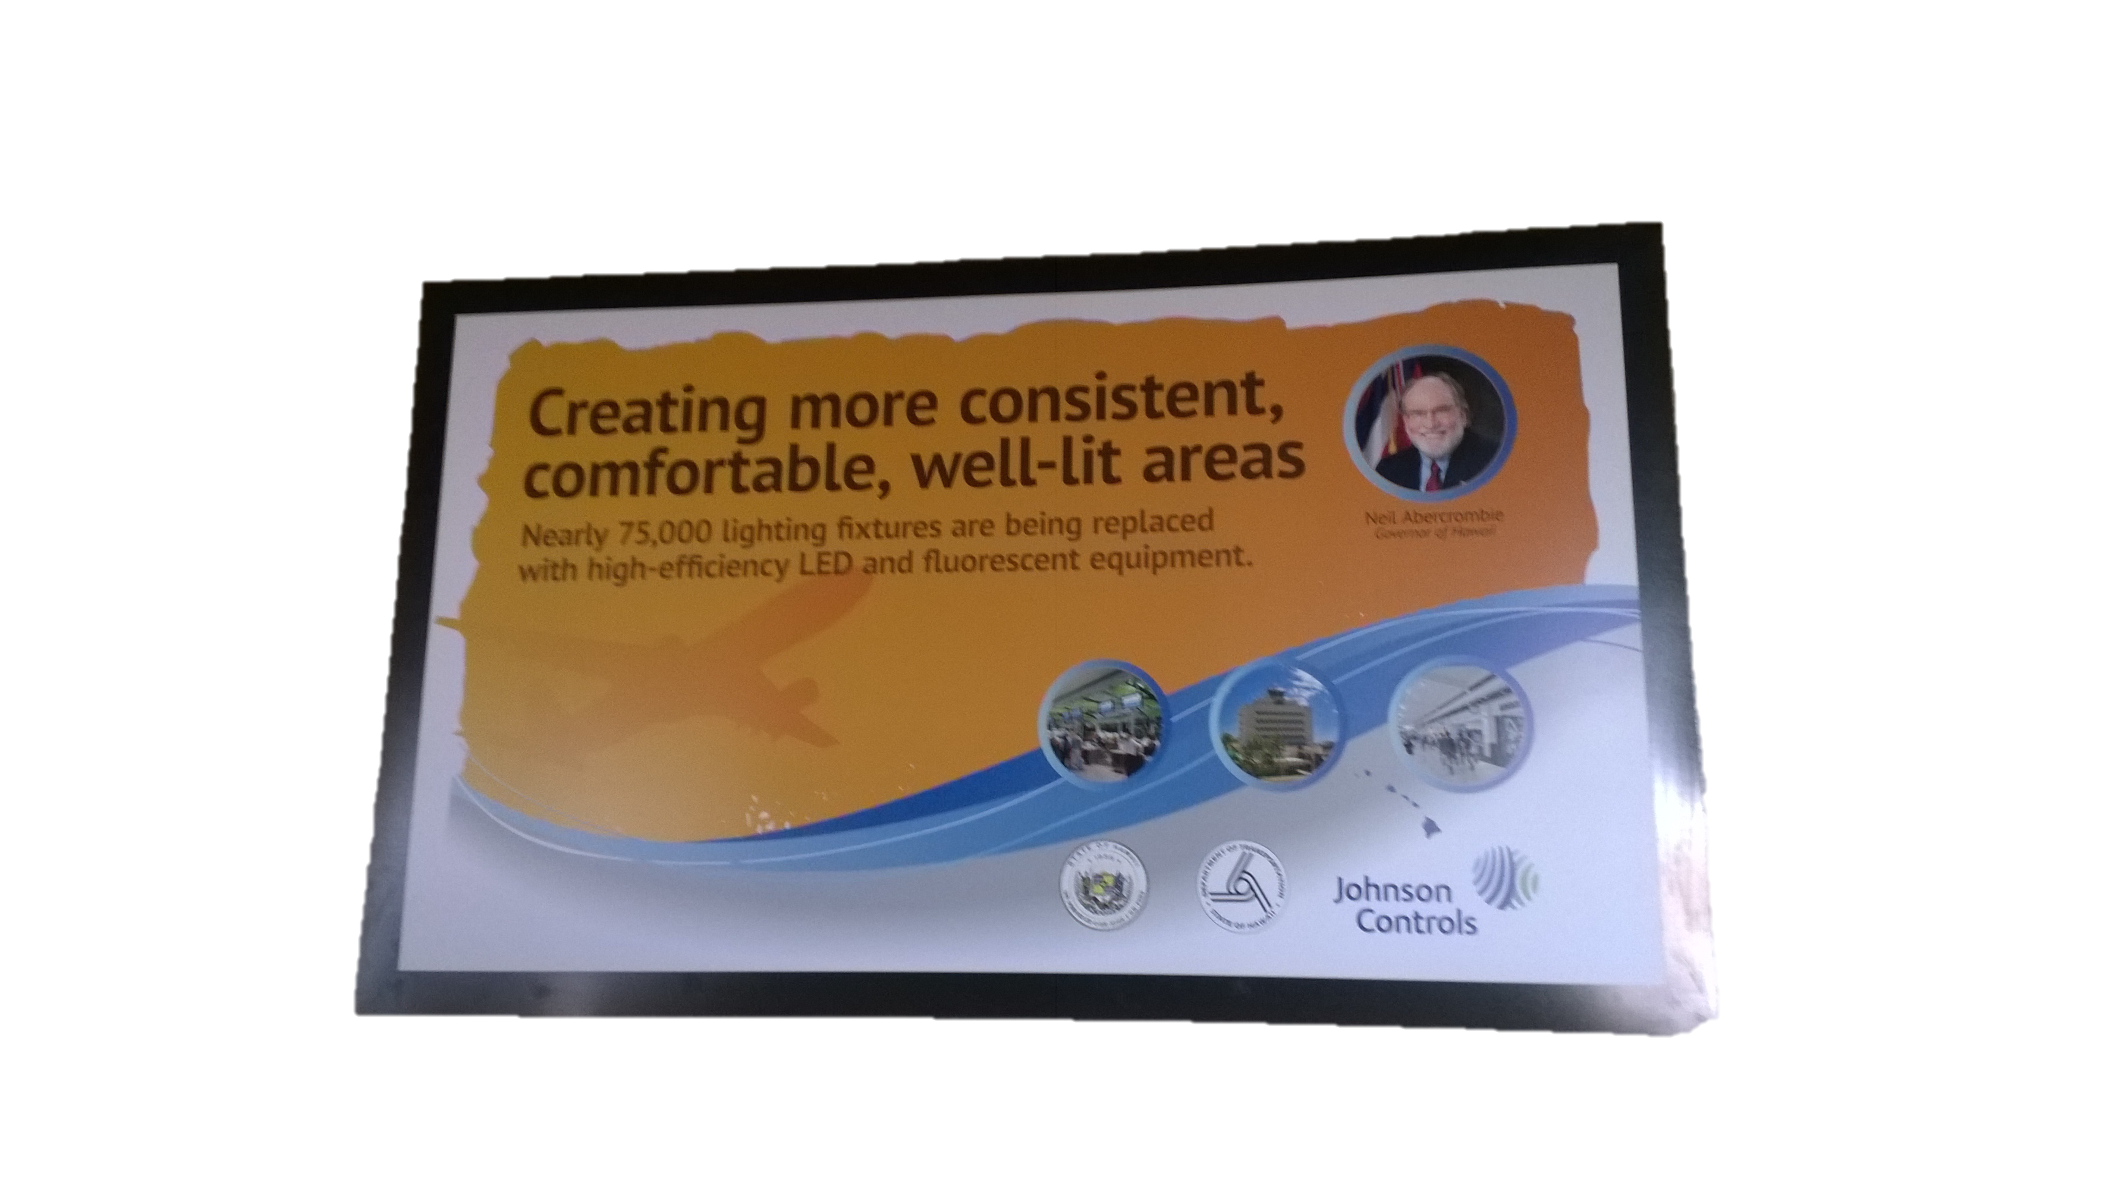
The LED Renaissance is a Once-in-a-Century Opportunity
1880s:
The first commercially viable
light bulbs are produced
1990s:
The first commercially viable
LED bulbs are produced
Soon:
LED lighting will achieve
~75% market share by 2030¹
¹N. Consulting. Energy savings potential of solid-state lighting in general illumination applications. U.S. Department of Energy, 2012.

Slide 27
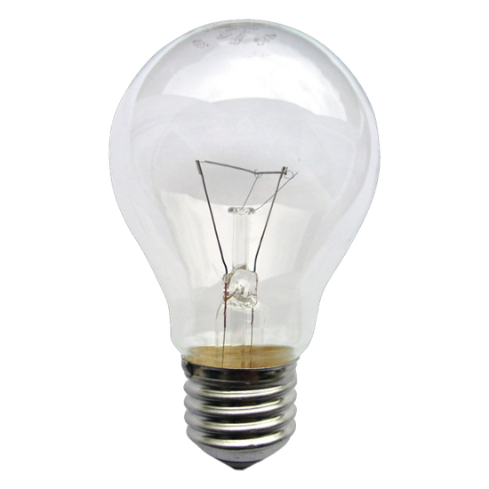
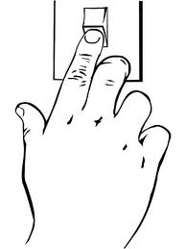
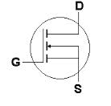
We cannot allow the solid state lighting revolution to be a simple substitute good
~10⁻⁴ Hz
~10⁴ Hz
00010100 →

Slide 28
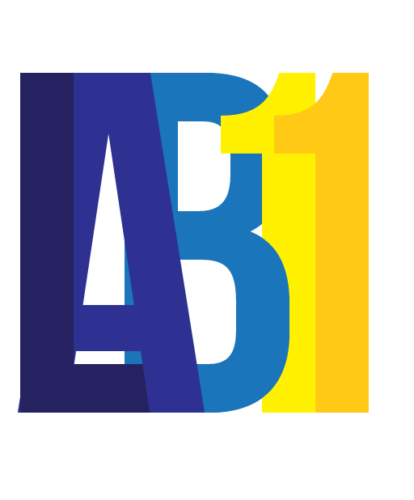
lab11.eecs.umich.edu

Slide 29
Unknowns in SDL design

Slide 30
Call to arms?

Slide 31
But why are we so excited about LEDs?
Because they’re diodes!
For the first time, we can modulate data – imperceptible to humans – on shared lighting infrastructure

Slide 32
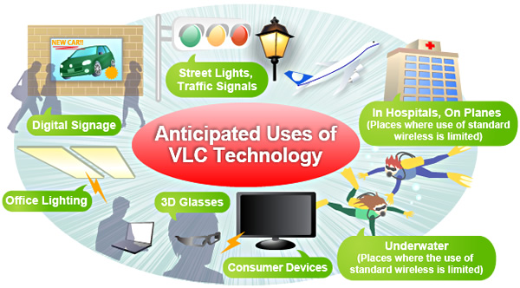
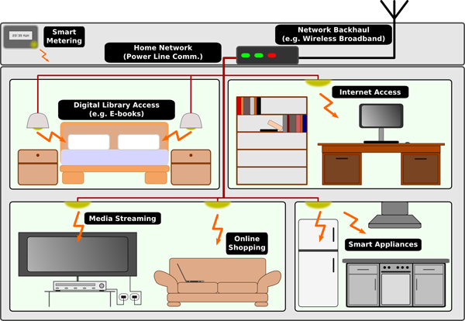
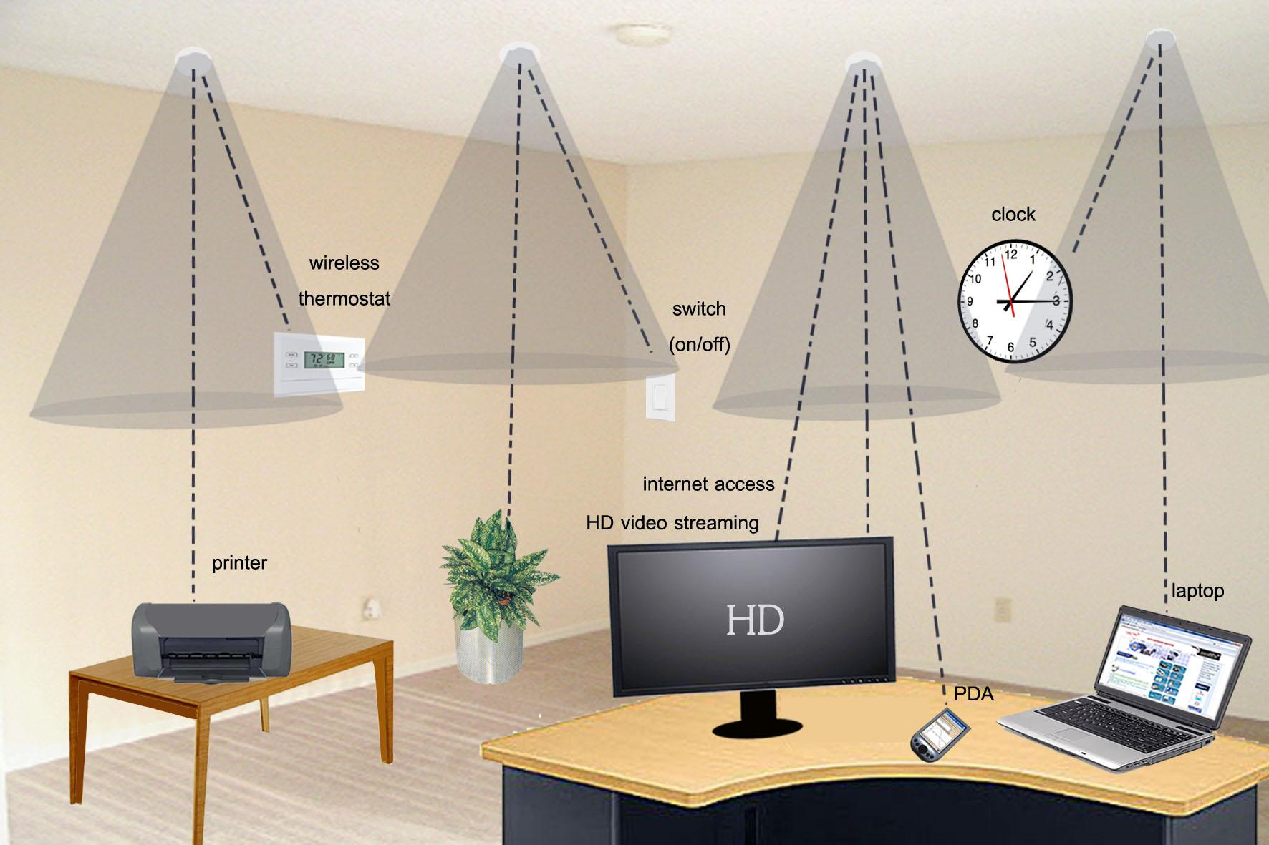
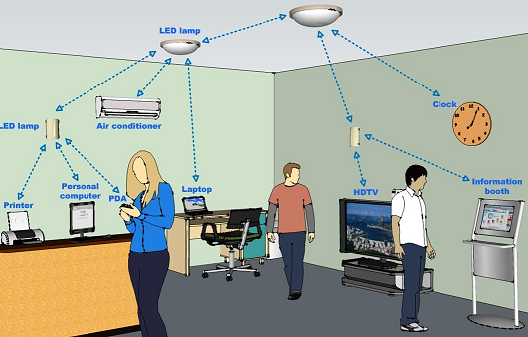
The $10 Billion Question: Is this architecture good for anything?

